Slide 1

“BUSINESS INSIGHT 360”
Presented By Hardik Anavadiya

Slide 2
AGENDA
1. Company Overview and Business Model
2. Problem Statement
3. What Is Business Insight 360
4. Tool Used and Process I Followed
5. Dashboard Walkthrough
6. Insight and Recommendations

Slide 3
COMPANY OVERVIEW AND BUSINESS MODEL
AtliQ Hardware is a Fast- Growing Global Company Specializing in Computer and Accessory sales across two main Platforms Brick & Mortar and E-Commerce.
They Operate through Three Primary Channel- Retailer, Direct Sales and Distributors.
Serving regions across APAC, LATAM, North America and Europe.

Slide 4
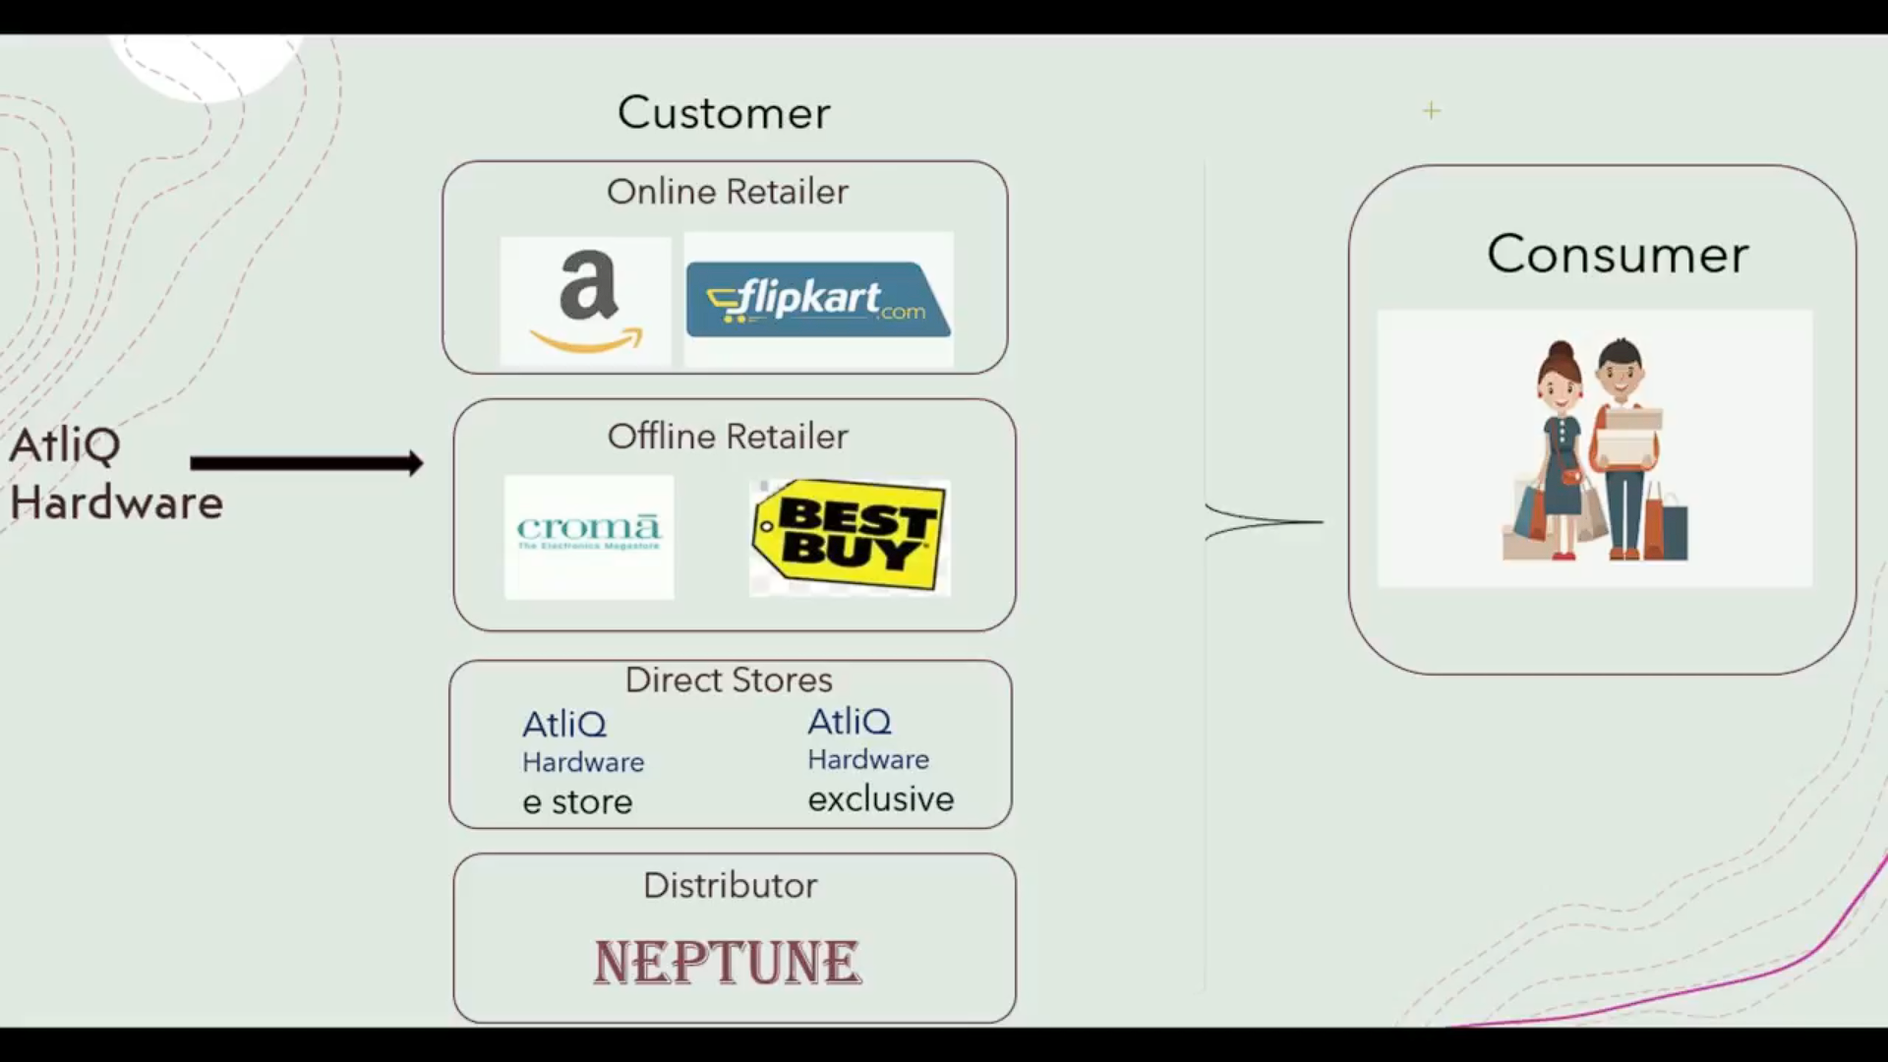

Slide 5
PROBLEM STATEMENT
Reliance on Intuition and Surveys For Decision Making led losses in Latin America
Challenges In managing and leveraging Big data.
Lack of transparency and accuracy in Data driven processes.
Necessity due to tough market competition.
Seeking More Opportunities for Business Growth.

Slide 6
What Is “Business Insight 360”?
Finance
Sales
Marketing
Supply Chain
Executive

Slide 7
Tool used & Process
Defining Objective
Data Gathering and
Preparation (ETL)
Data
Modelling
Report
Designing
Data
Visualizations
DAX
Formulas

